Slide 1

Welcome to Sabbath School
Illustration by Jo Card. Copyright © 2024 General Conference Corporation® of Seventh-day Adventists.

Slide 2

EARLY ARRIVALS
EARLY
ARRIVALS

Slide 3
Welcome to Sabbath School
Illustration by Jo Card. Copyright © 2024 General Conference Corporation® of Seventh-day Adventists.

Slide 4


Amazing
OPENING ACTIVITIES
Isn’t it amazing!
Isn’t it so wonderful
That God in heaven loves me.
He loves me oh so much.
(Repeat three times)
That God in heaven loves me.
He loves me oh so much.
"Amazing" by Kimberly Houliston, copyright © 2004 Abide Family Ministries. Used by permission.

Slide 5
Rest of My Life
OPENING ACTIVITIES
I won’t back down,
I won’t give up.
I’ll follow Jesus
No matter how tough it gets.
No matter what the problem,
No matter what the strife,
I’m with Jesus for the rest of my life.
(Continued on next slide)

Slide 6
Rest of My Life
OPENING ACTIVITIES
Because I won’t back down,
I won’t give up.
I’ll follow Jesus
No matter how tough it gets.
No matter what the problem,
No matter what the strife,
I’m with Jesus for the rest of my life.
(Repeat above)
I’m with Jesus for the rest of my life.(x2)
"Rest of My Life" by Kimberly Houliston, copyright © 2009 Abide Family Ministries. Used by permission.

Slide 7
Sabbath Song
OPENING ACTIVITIES
He made us, He saved us,
He’s coming back to take us home.
(Repeat two times)
Jesus, You are welcome in this place.
Father, You are welcome in this space.
Holy Spirit, fill our hearts with grace.
In this palace of time and space.
(Repeat above)
In this palace of time and space.
"Sabbath Song" by Alexandria and Leighton Heise, copyright © 2020, Alexandria and Leighton Heise. Used by permission.

Slide 8

PRAYER
PRAYER

Slide 9
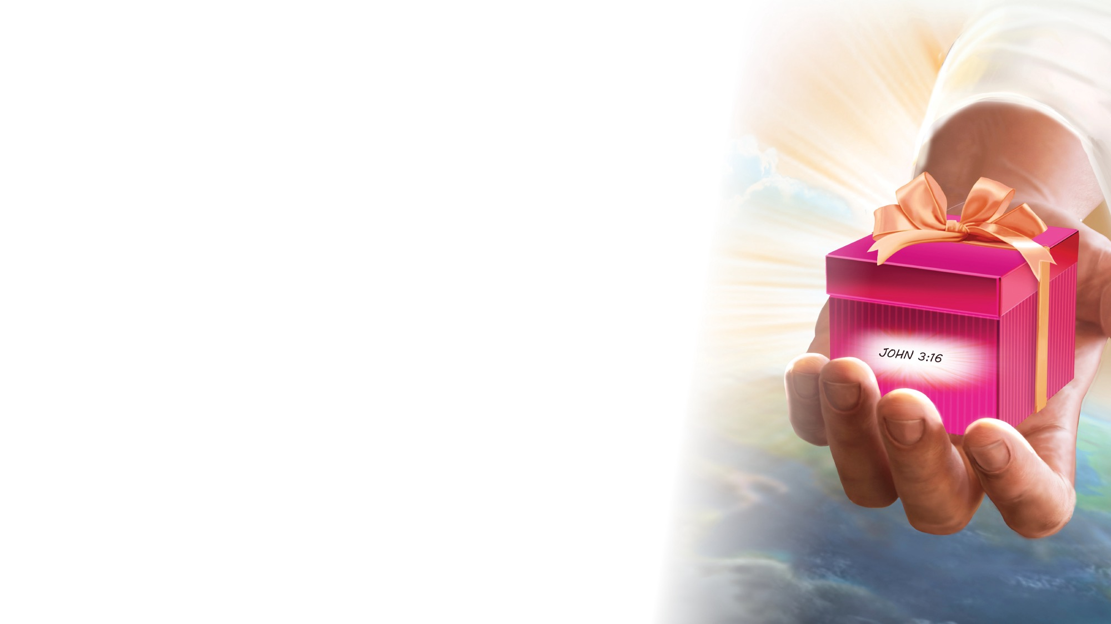
OFFERING

Slide 10

Thank You, Jesus
OPENING ACTIVITIES
Thank you, Jesus
For providing all my needs.
I want to give a little back
Of what you’ve given me.
Please bless our
Sabbath School offering.
May it bring You glory
And help others in need.
(Repeat above)
May it bring You glory
And help others in need.
"Thank You, Jesus" by Rosie Smith, copyright © 2024 General Conference Corporation® of Seventh-day Adventists.

Slide 11
MISSION
FAST FACT &
OFFERING
CHART

Slide 12
Visitor Song
OPENING ACTIVITIES
We have a new friend
With us today.
We have a new friend.
Let’s smile and wave.
We welcome you to Sabbath School.
We’re glad you came.
We welcome you,
And hope to see you again. (x2)
“Visitor Song” by Rosie Smith. Copyright © 2025 General Conference Corporation® of Seventh-day Adventists.

Slide 13
Happy Birthday
OPENING ACTIVITIES
Happy birthday, happy birthday,
Happy birthday to you.
Jesus loves you dear ___________.
Happy birthday to you.
(Repeat above)
“Happy Birthday” by Janet Sage, copyright © 2001 North American Division Corporation of Seventh-day Adventists. From Little Voices Praise Him, #39. Used by permission.

Slide 14

FOCUS
ACTIVITIES

Slide 15
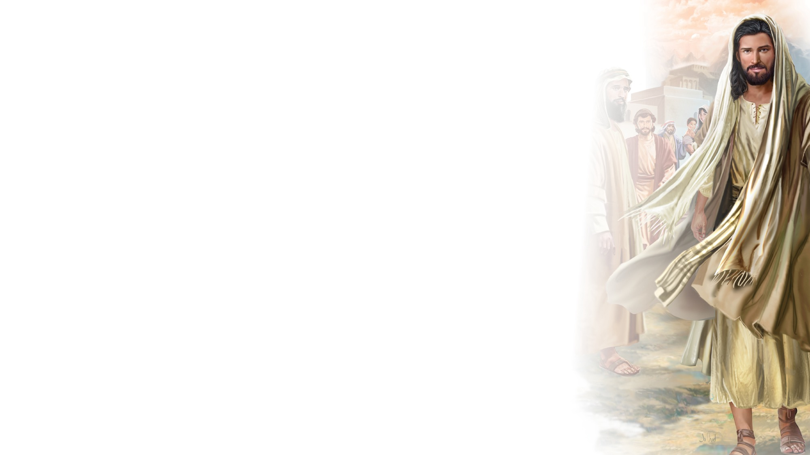
BIG IDEA
Jesus loves me so much He calls me to follow Him.

Slide 16

BIBLE
STORY

Slide 17
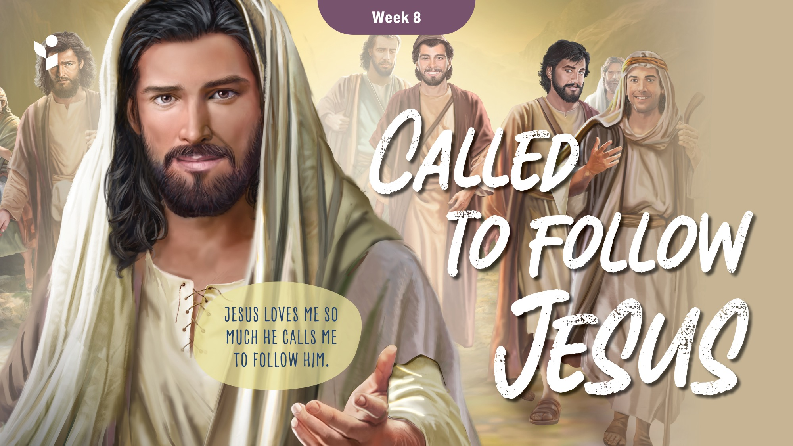

Slide 18
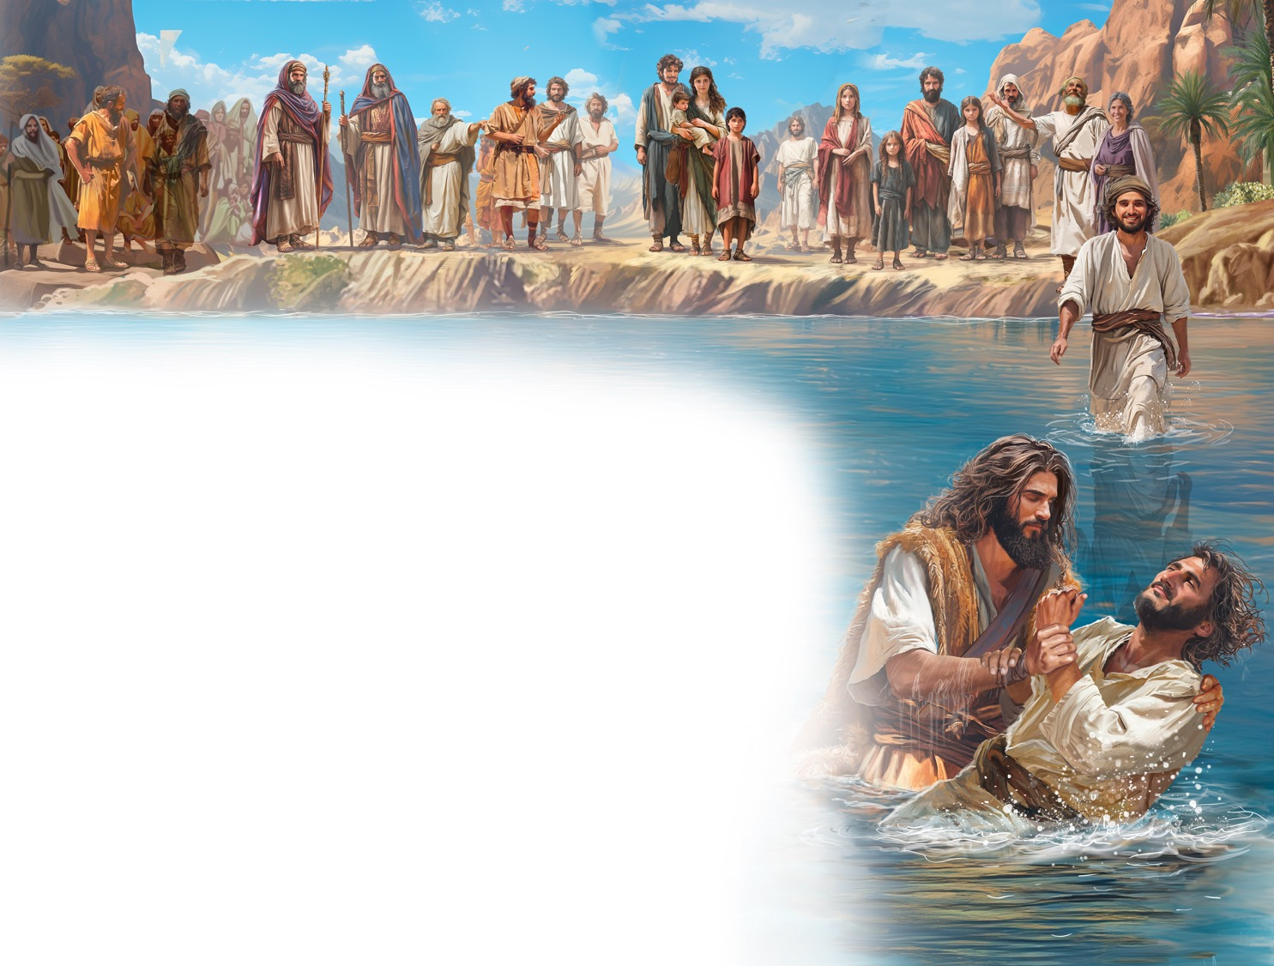
Illustration by Jo Card. Copyright © 2024 General Conference Corporation® of Seventh-day Adventists.

Slide 19
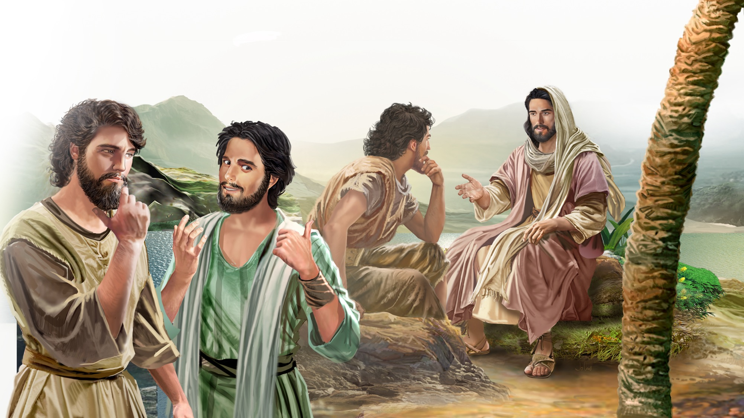
Illustration by Jo Card. Copyright © 2024 General Conference Corporation® of Seventh-day Adventists.

Slide 20
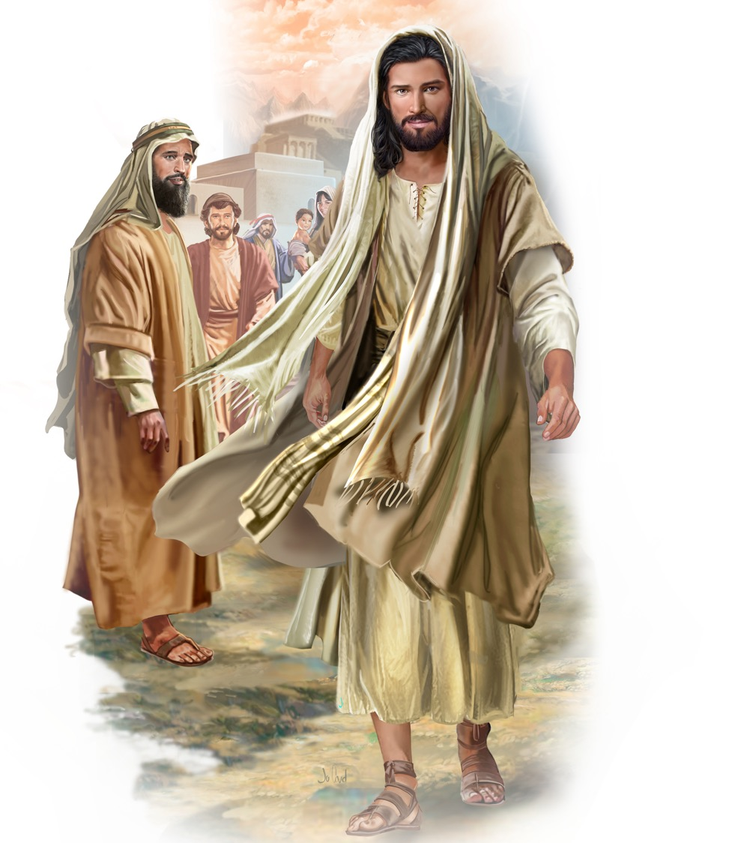
Illustration by Jo Card. Copyright © 2024 General Conference Corporation® of Seventh-day Adventists.

Slide 21
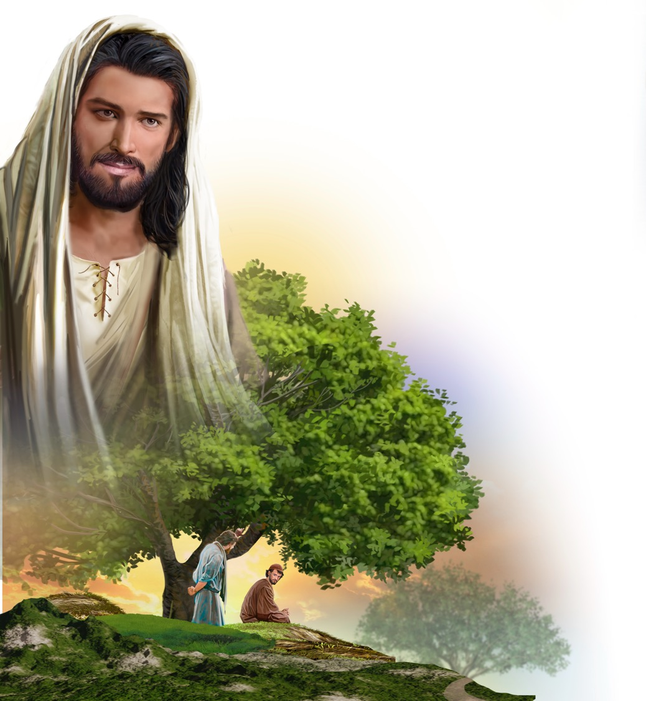
Illustration by Jo Card. Copyright © 2024 General Conference Corporation® of Seventh-day Adventists.

Slide 22
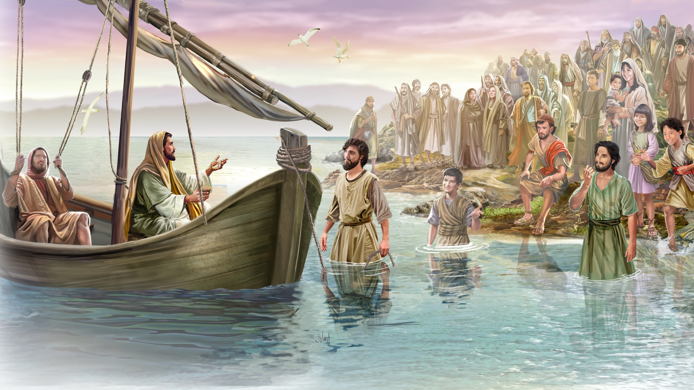
Illustration by Jo Card. Copyright © 2024 General Conference Corporation® of Seventh-day Adventists.

Slide 23
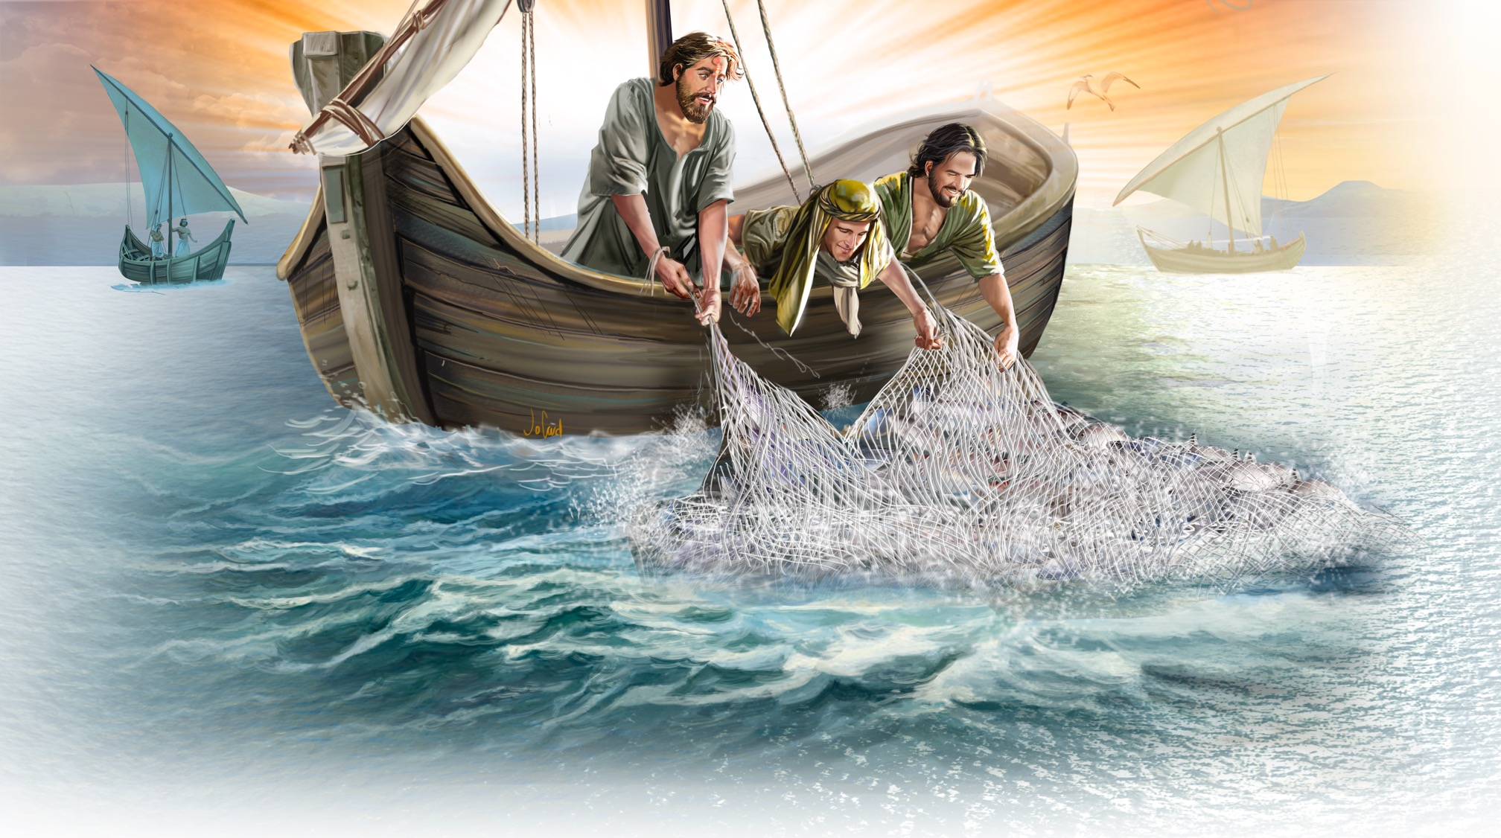
Illustration by Jo Card. Copyright © 2024 General Conference Corporation® of Seventh-day Adventists.

Slide 24
UNPACK
THE STORY

Slide 25
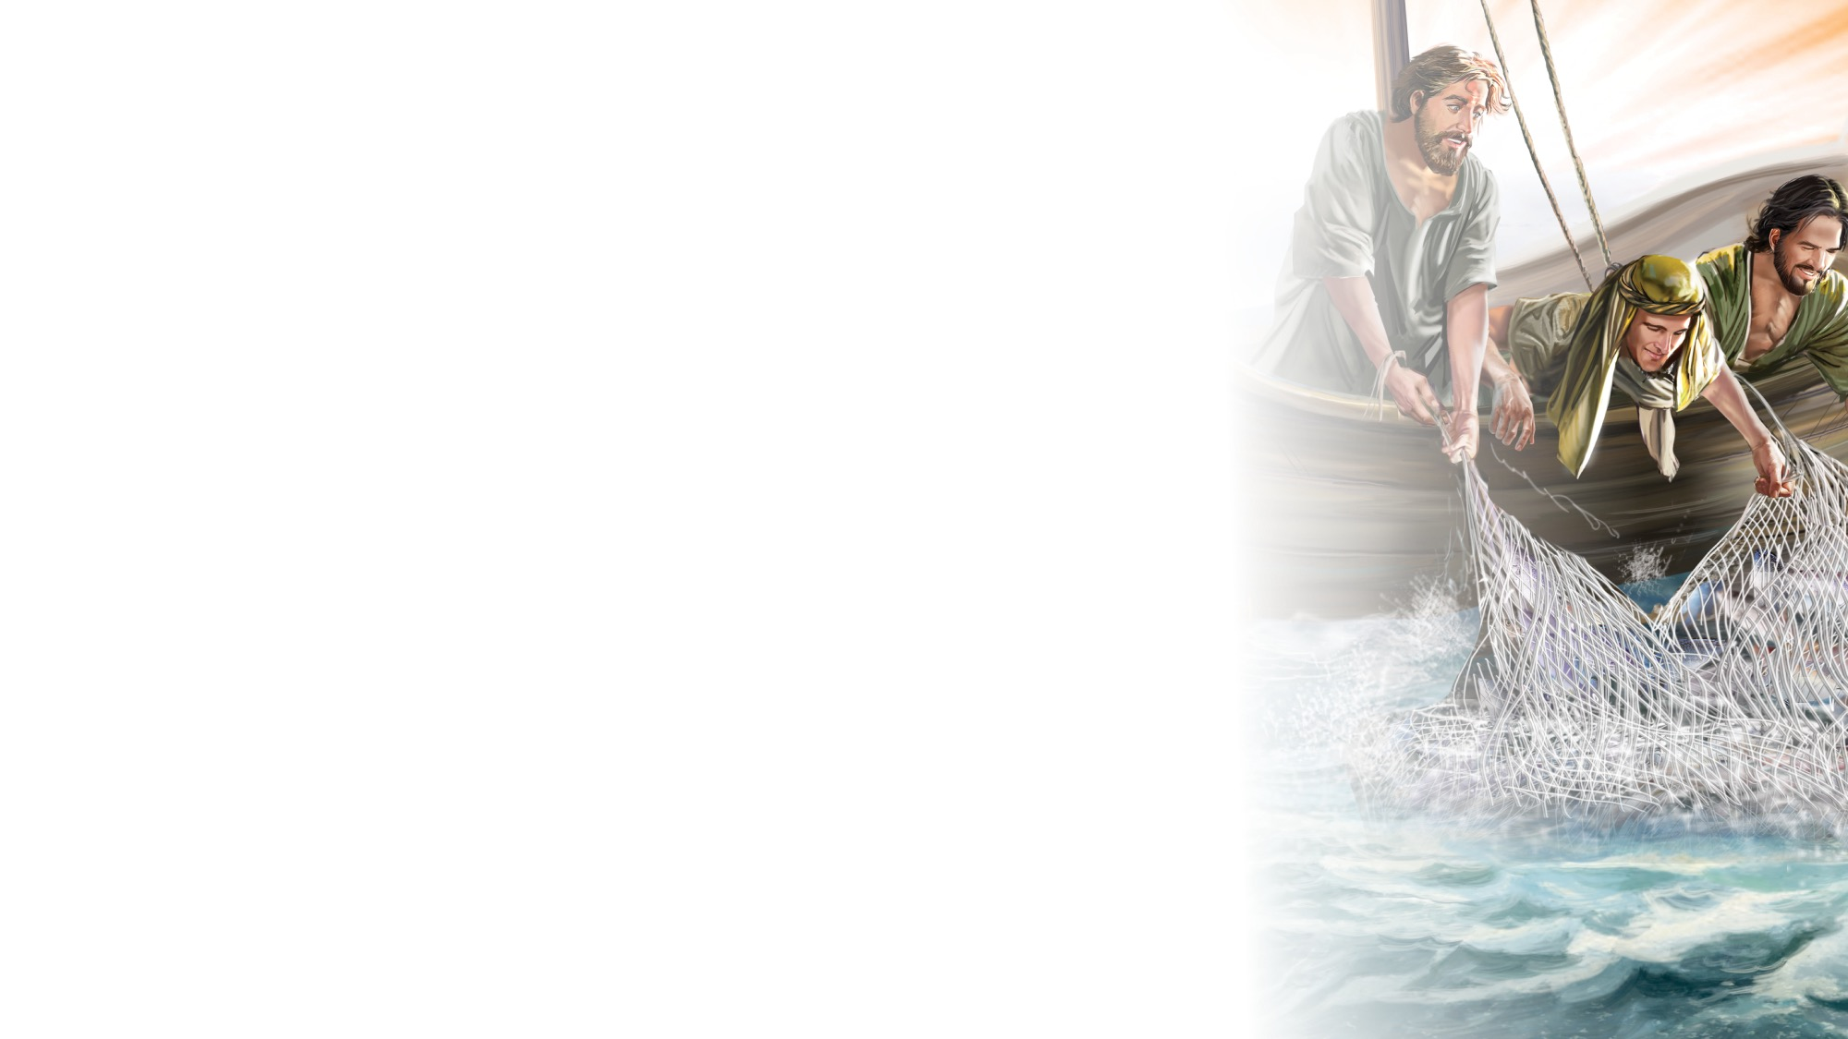
All the Time
UNPACK THE STORY
(Chorus)
All the time, all the time,
All the time, gonna follow Jesus.
All the time, all the time,
I’m gonna follow Him.
(Repeat chorus)
Not just when I’m feeling good,
But all the time gonna follow Jesus,
Follow what He wants me to.
I’m gonna follow Him.
Even when I’m having a really bad day
All the time I’m gonna follow Jesus.
I am still gonna say that,
I’m gonna follow Him.
(Repeat chorus 2x)
I’m gonna follow Him. (2x)
"All the Time" by Kimberly Houliston, copyright © 2017 Abide Family Ministries. Used by permission.

Slide 26

CHARACTER CARDS

Slide 27
John 8:12
SCRIPTURE SONG
Then Jesus spoke to them again, Saying, “I am the light of the world.
He who follows Me
Shall not walk in darkness,
But have the light of life.”
John chapter 8 and verse 12.
(Repeat above)
"John 8:12" music by Rosie Smith, copyright © 2026 General Conference Corporation® of Seventh-day Adventists.

Slide 28
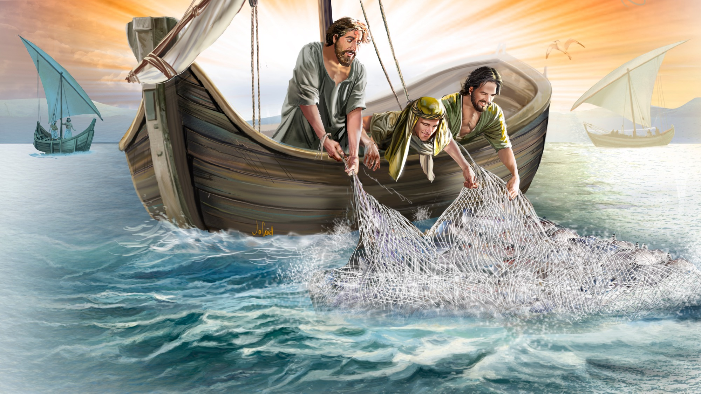
MEMORY VERSE
“Then Jesus spoke to them again saying,
‘I am the light of the world. He who follows me shall not walk in darkness, but have the light of life.’”
John 8:12

Slide 29
All the Time
TIE IT ALL TOGETHER
(Chorus)
All the time, all the time,
All the time, gonna follow Jesus.
All the time, all the time,
I’m gonna follow Him.
(Repeat chorus)
Not just when I’m feeling good,
But all the time gonna follow Jesus,
Follow what He wants me to.
I’m gonna follow Him.
Even when I’m having a really bad day
All the time I’m gonna follow Jesus.
I am still gonna say that,
I’m gonna follow Him.
(Repeat chorus 2x)
I’m gonna follow Him. (2x)
"All the Time" by Kimberly Houliston, copyright © 2017 Abide Family Ministries. Used by permission.

Slide 30
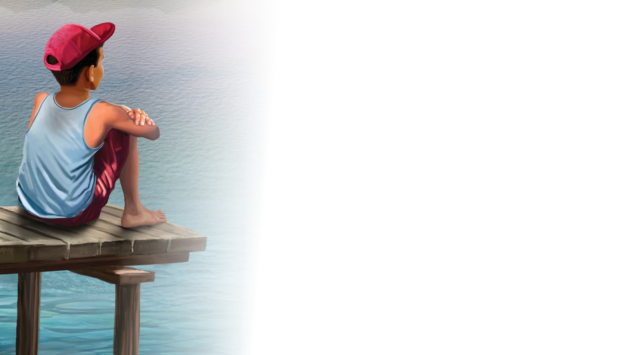
NATURE
LESSON

Slide 31

CRAFT

Slide 32
I Will Make You Fishers of Men (acapella)
CRAFT
I will make you fishers of men,
Fishers of men, fishers of men.
I will make you fishers of men,
If you follow Me.
If you follow Me.
If you follow Me.
I will make you fishers of men,
If you follow me.

Slide 33
CRAFT

Slide 34

MISSION
CHALLENGE

Slide 35
BIG IDEA
Jesus loves me so much He calls me to follow Him.

Slide 36

All the Time
CLOSING SONG
All the time, all the time,
All the time gonna follow Jesus.
All the time, all the time,
I’m gonna follow Him.
(Repeat above)
"All the Time" by Kimberly Houliston, copyright © 2017 Abide Family Ministries. Used by permission.

Slide 37

PRAYER
PRAYER

